Slide 1
Multivariate Analysis of Variance, Part 2
BMTRY 726

Slide 2
Two-way MANOVA
What happens if we have more than two independent populations we want to compare?
Consider the univariate case with treatments l and k
The expected response for the k^{th} a l^{th} levels is
Mean
Response
Overall
level
Factor 1
Effect
Factor 2
Effect
Factor
Interaction
Effect

Slide 3
Visualize the Data
Suppose we have data with two factors
-treatment A has g = 1,2,3 levels
-treatment B has b = 1,2,3,4 levels

Slide 4
Two-way MANOVA
We can easily extend this to the multivariate case:
Assumptions:
-These are all p x 1 vectors and all ε_{lkr} ∼Ν (0,Σ) are independent random vectors.
-We also constrain the model such that
The response includes p measures replicated n times at each possible combination of treatments 1 and 2.

Slide 5
Two-way MANOVA
We can decompose this as follows:

Slide 6
From this we can derive the MANOVA table:
Source VariationI | Matrix Sum of Squares | Degrees of Freedom
Treatment 1
Treatment 2
Interaction
Residual
Total

Slide 7
Hypothesis Tests
Generally start by testing for interactions…
We can test this hypothesis using Wilk’s lambda
NOTE: The LRT requires p < gb(n-1) so SSP_{res} will be positive definite

Slide 8
Hypothesis Tests
If we fail to reject the null of an interaction effect, we should then test for our factor effects:
We can test this hypothesis using Wilk’s lambda

Slide 9
Hypothesis Tests
Note a critical value based on a χ² distribution better for large n
For small samples we can compute an F-statistic since this is (sometimes) an exact distribution
However, the d.f. are complicated to estimate- the book example works for g = b = 2:

Slide 10
Confidence Intervals
As with the one-way MANOVA case, we can estimate Bonferroni confidence intervals

Slide 11
Example: Cognitive impairment in Parkinson’s Disease
It is known that lesions in the pre-frontal cortex are responsible for much of the motor dysfunction subject’s with Parkinson’s disease experience.
Cognitive impairment is a less well studied adverse outcome in Parkinson’s disease.
An investigator hypothesizes that lesions in the locus coeruleus region of the brain are in part responsible for this cognitive deficit.
The PI also hypothesizes that this is partly due to decreased expression of BDNF.

Slide 12
Experimental Design
The PI wants to investigate the effect of lesion location on cognitive behavior in Parkinson’s model rats.
She also wants to investigate a therapeutic application of BDNF on cognitive performance.
-Outcomes
-Novel Object Recognition (NOR)
-Water Radial Arm Maze (WRAM)
Two experimental factors for six groups:
-Lesion type
-6-OHDA
-DSP-4
-Double
-Therapy
-BDNF microspheres
-No treatment

Slide 13
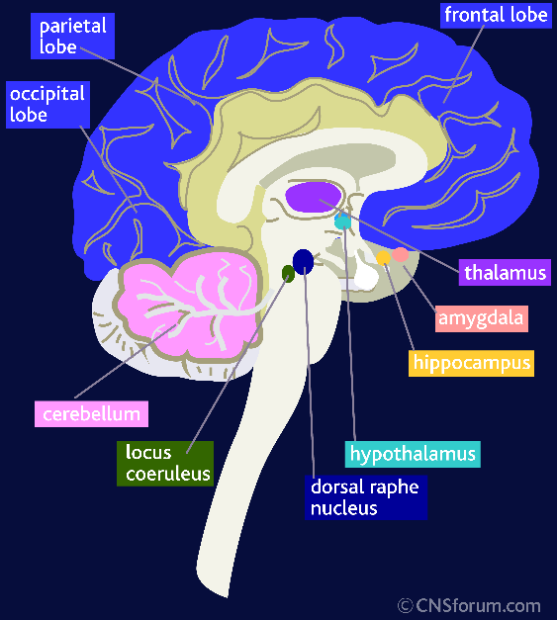
DSP-4 Lesions effect
noradrenergic pathways
in the LC
Two groups of rats receive
these single lesions
-No treatment
-BDNF Treated

Slide 14
6-OHDA Lesions effect
dopaminergic pathways
in the PFC
Two groups of rats receive
these single lesions
-No treatment
-BDNF Treated

Slide 15
Double lesion animals
receive both 6-OHDA and
DSP-4 lesions affecting
the LC and PFC
Two groups of rats receive
these single lesions
-No treatment
-BDNF Treated

Slide 16
The data
The data are arranged in an
array.
The six matrices represent
the six possible combos
of treatment and lesion type
Column 1 in each matrix are
the NOR task results
Column 2 in each matrix are
the WARM task results

Slide 17
Means for Sums of Squares

Slide 18
Sums of Squares

Slide 19
Hypothesis testing

Slide 20
Hypothesis testing

Slide 21
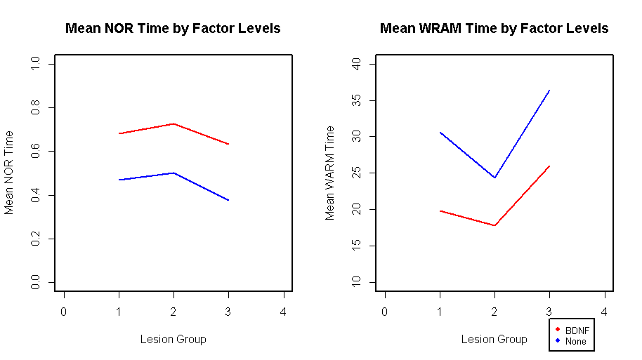
A Graphical View of Our Results

Slide 22
Bonferroni Simultaneous CIs

Slide 23
Bonferroni Simultaneous CIs

Slide 24
Conclusions from the Parkinson’s Study
There is not a significant interaction between lesion type and BDNF therapy.
Treatment with BDNF in a Parkinson’s rat model significantly increased the mean time rats spent in the NOR task.
Treatment with BDNF in a Parkinson’s rat model significantly decreased the time rats needed to complete the WRAM task.
Rats with double lesions spent significantly short time with novel objects relative to 6OHDA lesioned rats.
Double lesioned rats took a significantly longer amount of time to complete the WRAM task relative to 6OHDA rats.

